Slide 1
PHILIPPINE CARTOONS: POLITICAL CARICATURES OF THE AMERICAN ERA 1900-1941
Presented by: Group 5
John Alfred Butnande Patrick Martin Castro Young Seo Park Sean Kenneth Arenal Hover Tiangchon
Professor: Syvel Silvestre

Slide 2

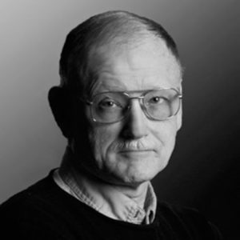
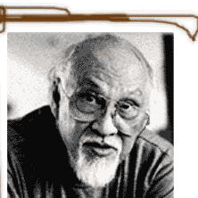
Authors
Alfred W. Mccoy
Alfred "Al" William McCoy is an American historian and educator. He is the Fred Harvey Harrington Professor of History at the University of Wisconsin–Madison.
Alfredo R. Roces
Alfredo Roces is a Filipino Postwar & Contemporary painter who was born in 1932.

Slide 3
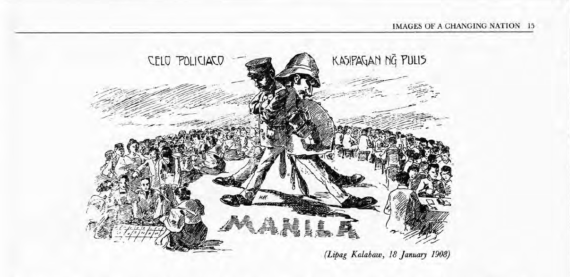
The Cartoons
The Corruption of a City
The Distant Provinces
The Colonial Condition
Uncle Sam and Little Juan
The Aliens in our Midst
The Political Pageant
An Emerging Nation

Slide 4
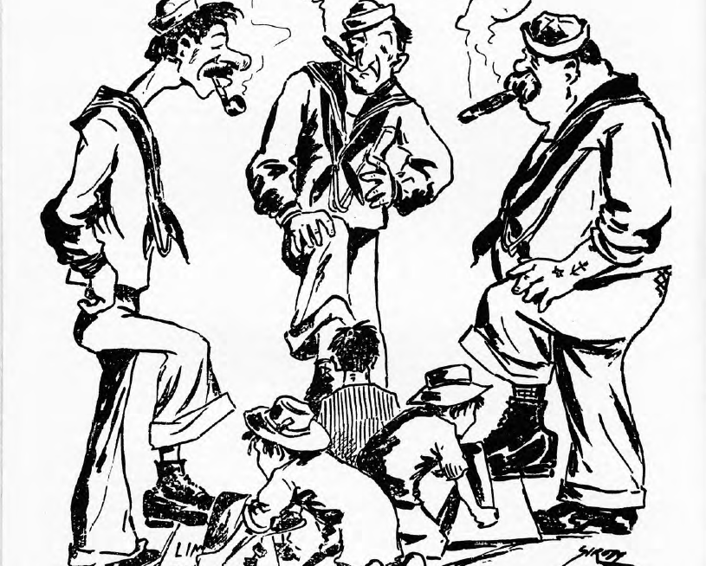
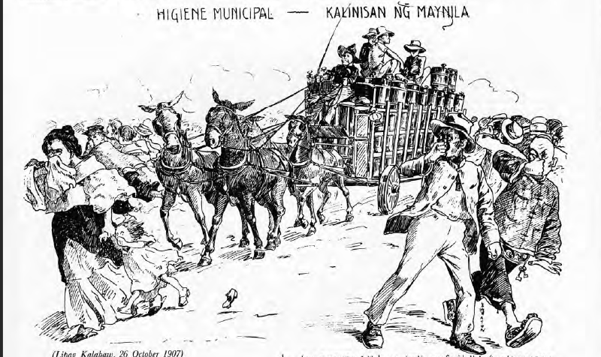
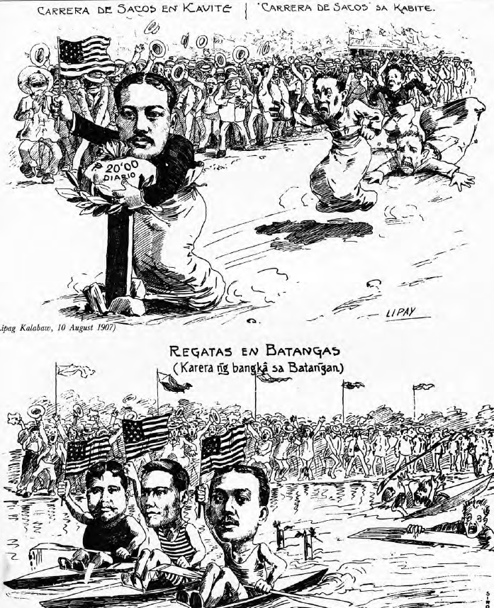
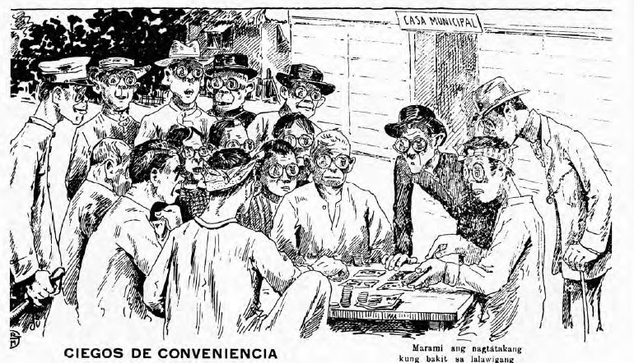
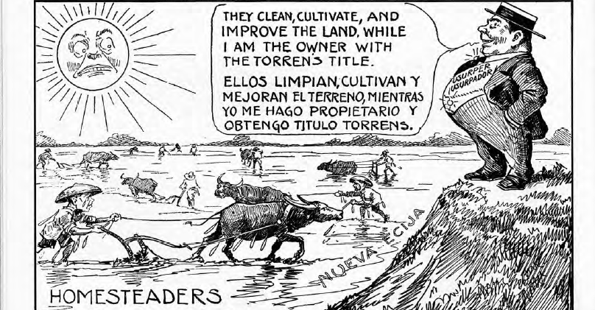
Caricatures?
caricature and cartoon, in graphic art, comically distorted drawing or likeness, done with the purpose of satirizing or ridiculing its subject. Cartoons are used today primarily for conveying political commentary and editorial opinion in newspapers and for social comedy and visual wit in magazines.

Slide 5
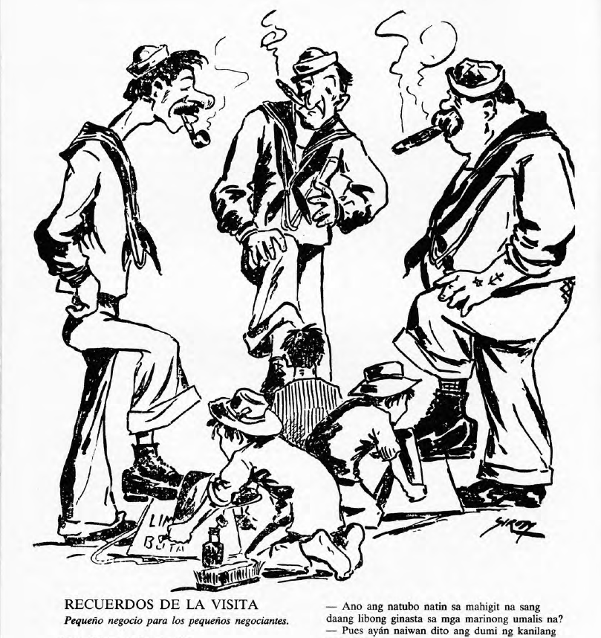
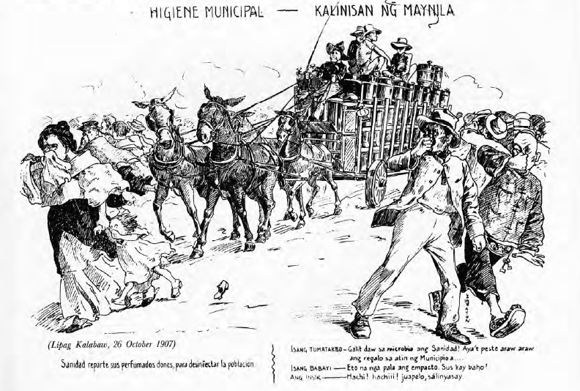
The Corruption of a City
Memories of the Visit
Municipal Hygiene

Slide 6
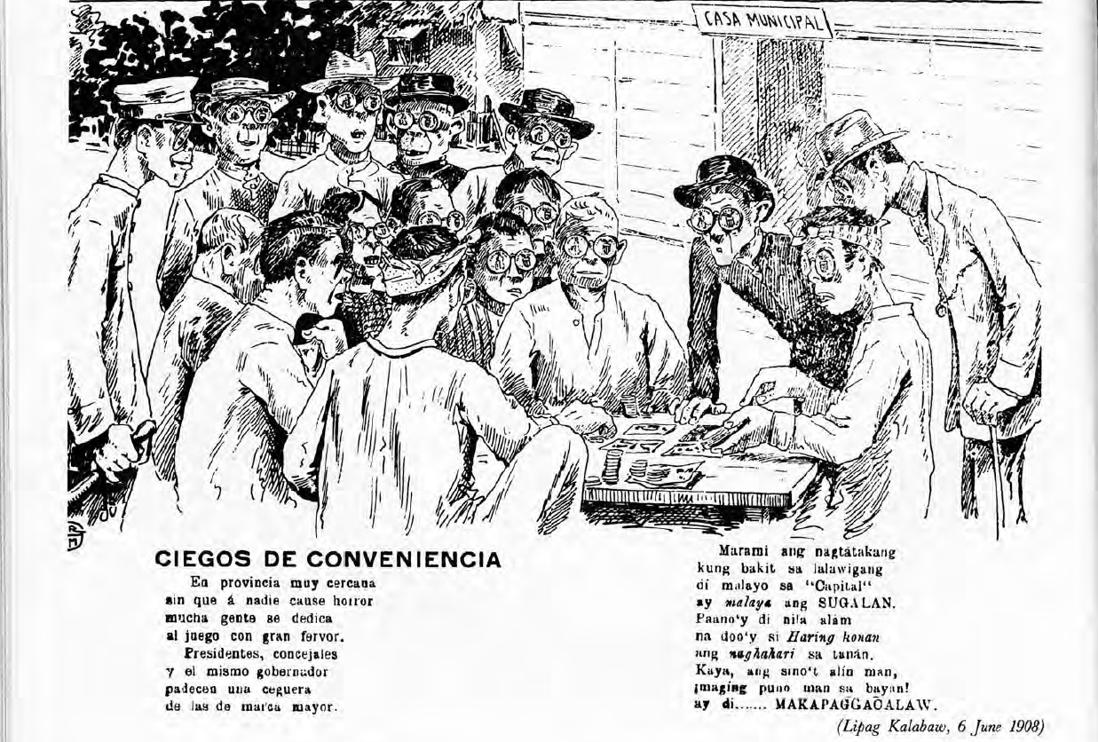
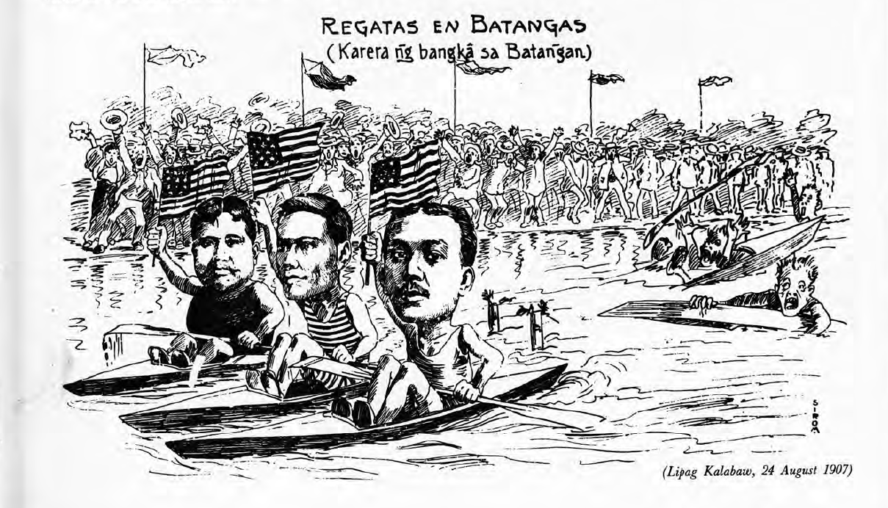
The Distant Provinces
Convenient Blindness
Regattas in Batangas

Slide 7
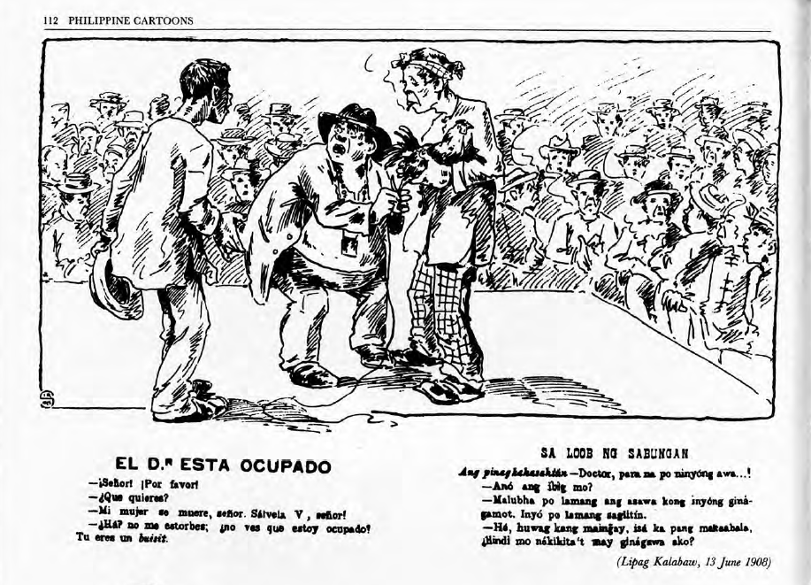
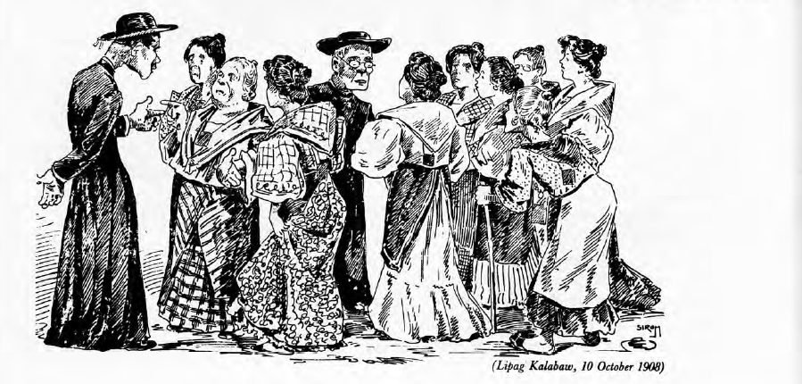
The Colonial Condition
The Doctor is Busy
A Mass is Better

Slide 8
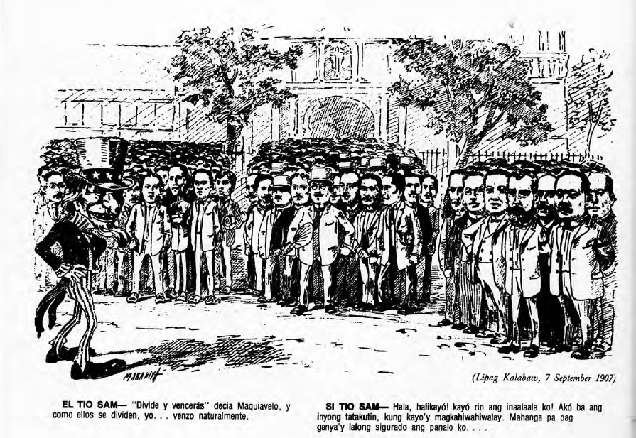
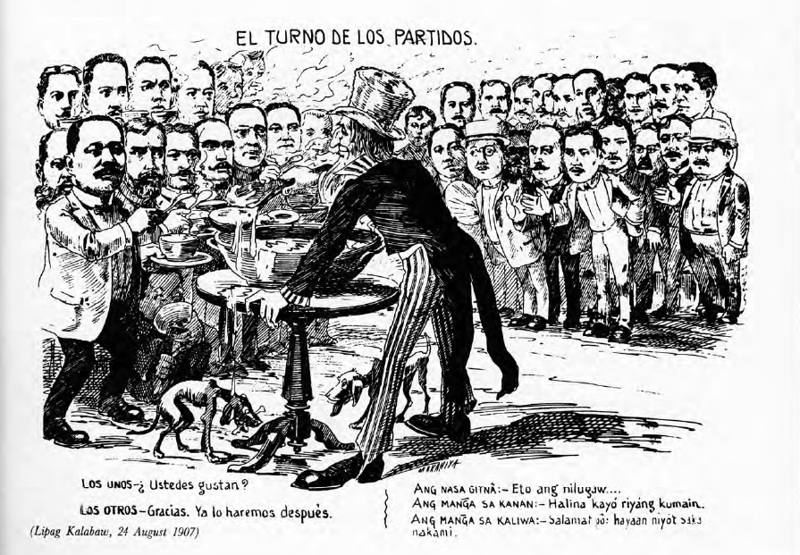
Uncle Sam and Little Juan
Uncle Sam
The Parties Take Turns

Slide 9
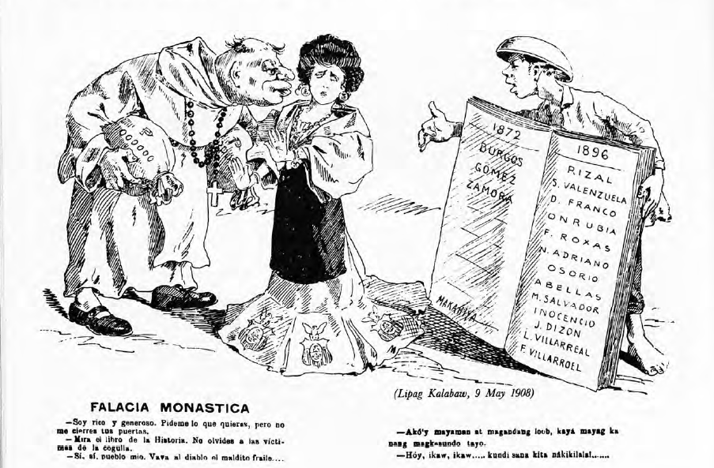
The Aliens in our Midst
Fria Deceit
The Parties Take Turns

Slide 10


Include an iconic picture from the era.

Slide 11

Famous person
Famous person from the era:
Add an image of a famous person from the era and then explain his/her significance.
You could also use a slide like this to capture an important event during the era.

Slide 12
Letter from the generation
Things to reflect on when writing the letter:
How would they like to be remembered?
What message would they want to share?
Would they give future generations any advice? If so, what would it be?
What do you think the people who lived in that era would say to you about their lives and experiences?
Include a message from the generation to future generations who find the time capsule.
Signed by Gen XYZ

Slide 13
Final slide
Wrap up the trip into history and add your final thoughts, ideas, and questions.
Wrap up description
Wrap up description
Wrap up description

Slide 14
Customize this Template
Template Editing Instructions and Feedback

